Slide 1

Motor Vehicle Deaths
Jenny Eberling

Slide 2
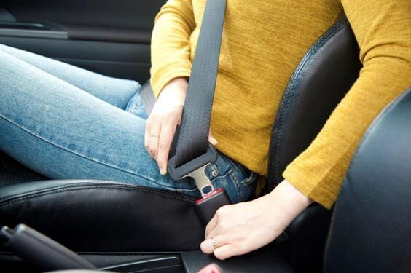
About the Data
US Statistics
From the National Highway Traffic Safety Administration
Organized on Wikipedia
Motorized Vehicle Deaths (Yearly total)
1899 – 2018
Secondary time series
Two indicators
Notes:
Population
Vehicle Miles Traveled (billions) (VMT)
Fatalities per 100 million VMT
Fatalities per 100,000 population
Change in per capita fatalities from year to year
Bicycle deaths
Motorcycle deaths

Slide 3



Goals
Model motorized vehicle deaths
Seasonality?
Make predictions for next 5 years

Slide 4
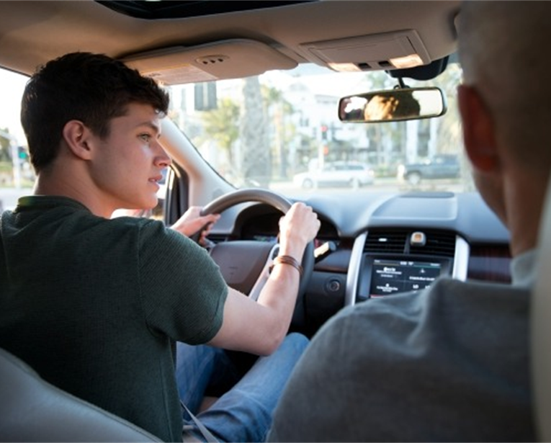
Plan
FIRST
Look at how the time series relate
CCFs for predictors + MVD
Model motor vehicle deaths with ARIMA
Model motor vehicle deaths with linear model
ARMA residuals
THEN
Look at time series from 1945 onward
Better than full data set?

Slide 5
Data

Slide 6
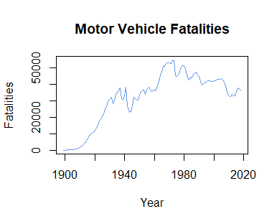
Original
No logical season
1968 – Federal Motor Vehicle Safety Standard 208
1984 – Drinking Age
Troughs in 1942, 1974, 1983, 1992, 2010
Notes:
Tried running with seasonal components
Periods of 7, 12, 120
1984 – NY is first state to pass seatbelt law

Slide 7
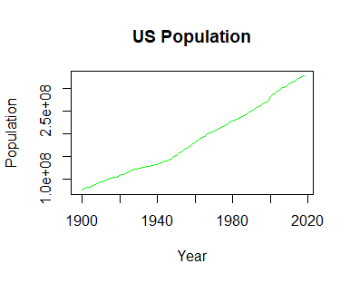
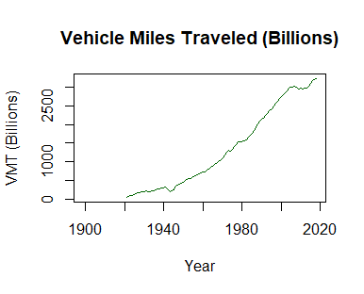
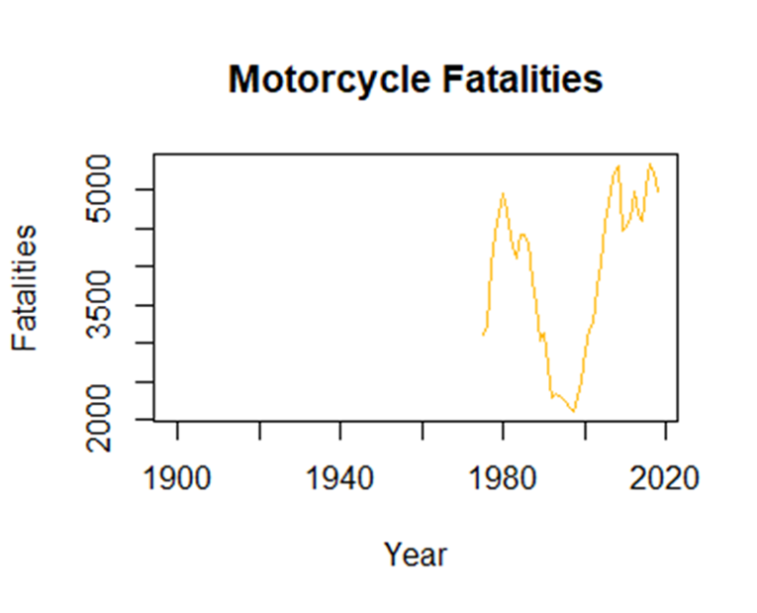
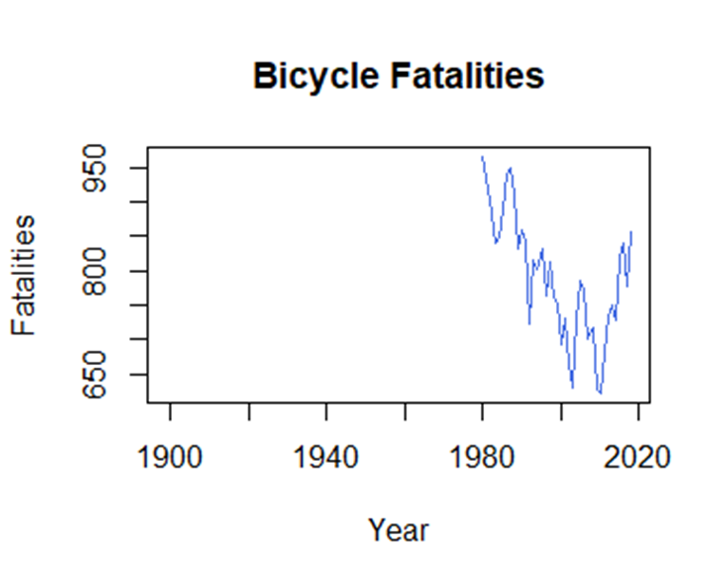

Slide 8
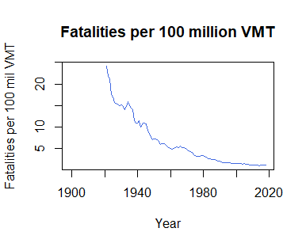
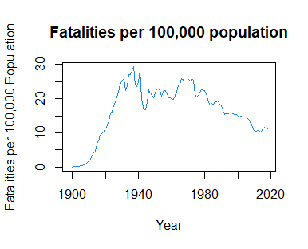
Notes:
Very little correlation between fatalities and population

Slide 9
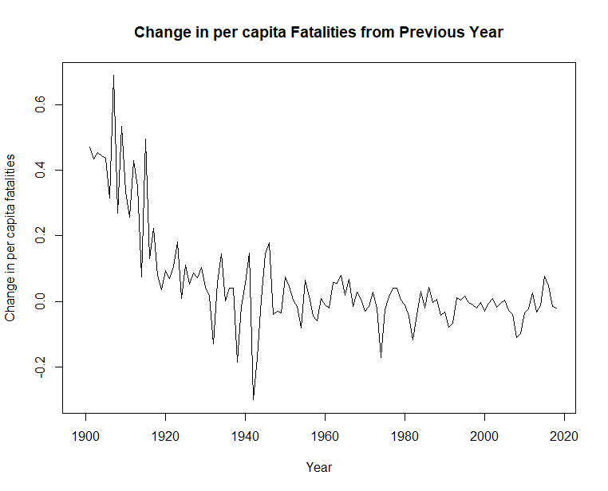

Slide 10
CCF’s

Slide 11
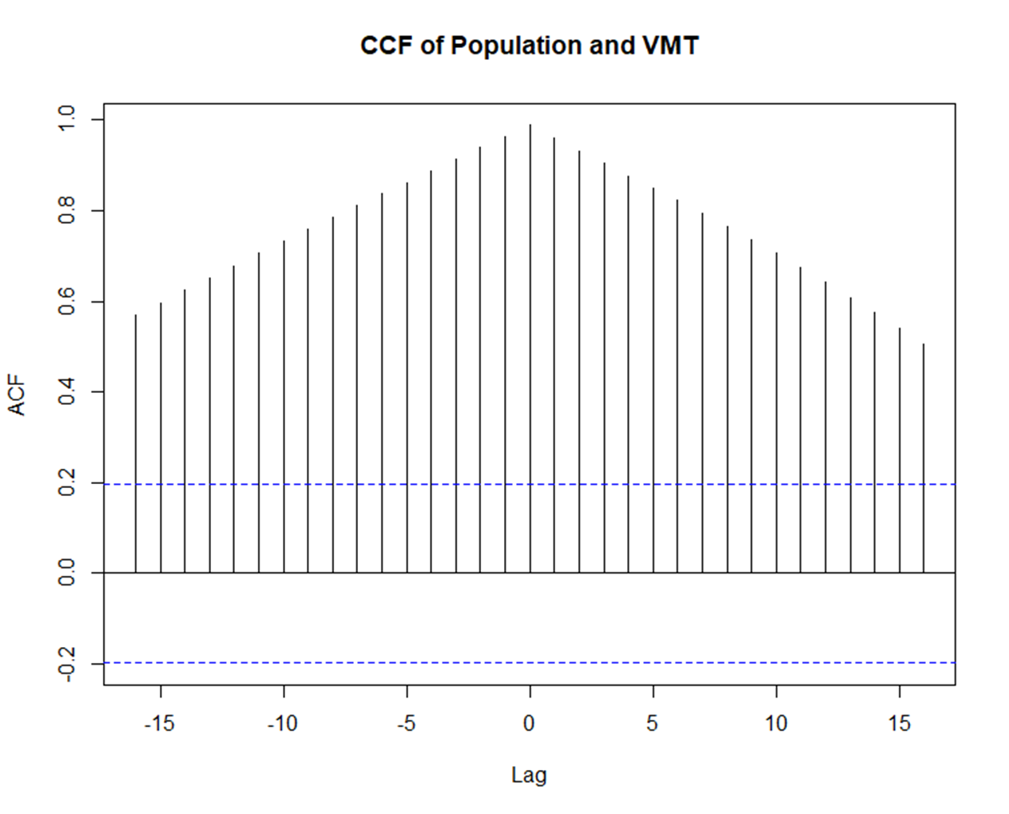
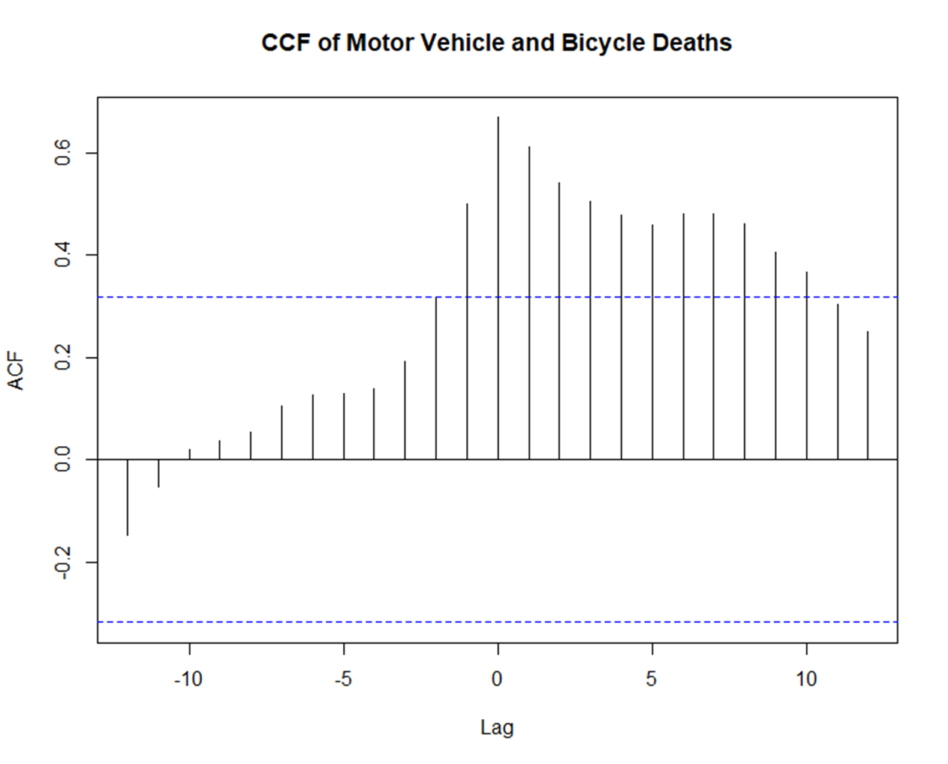
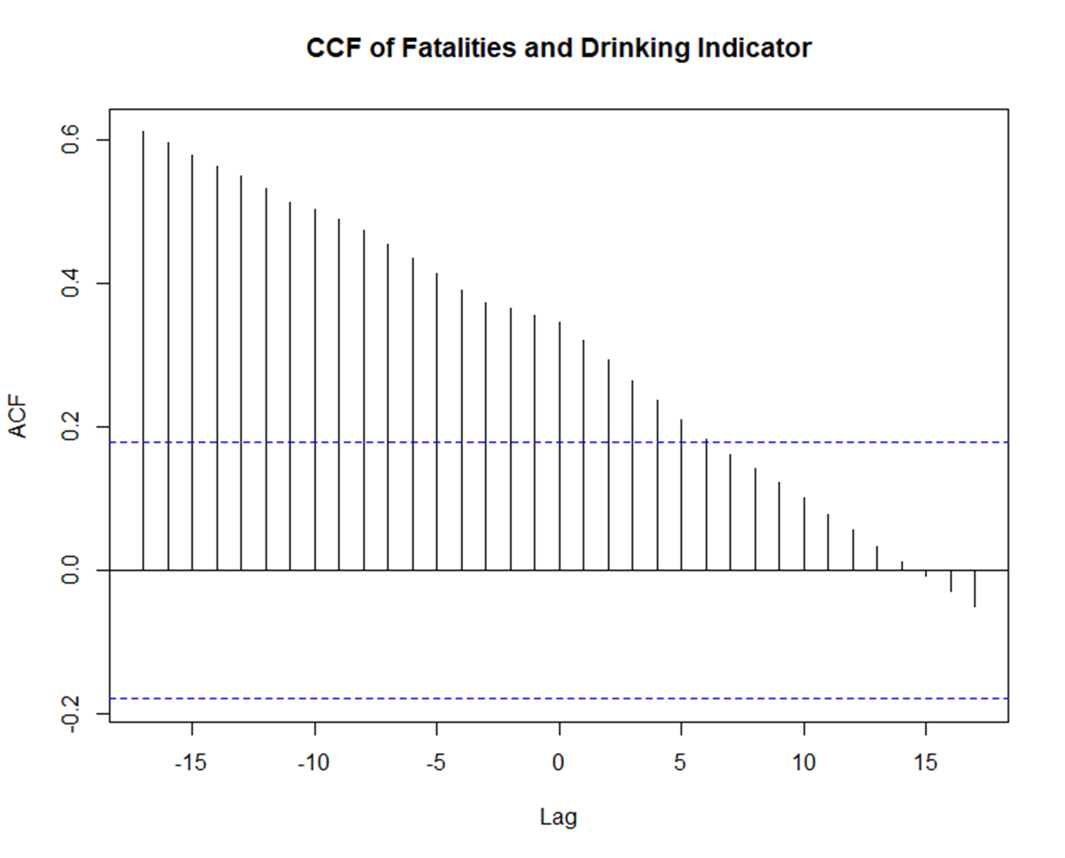

Slide 12
Modeling
ARIMA, Linear Model

Slide 13
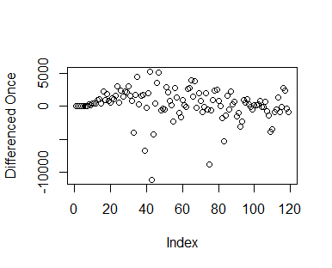
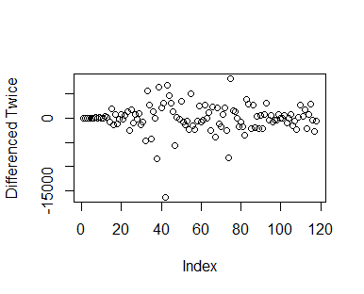
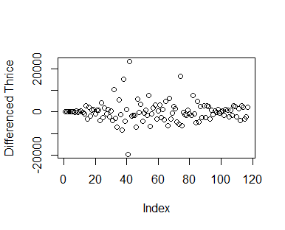
Differencing

Slide 14
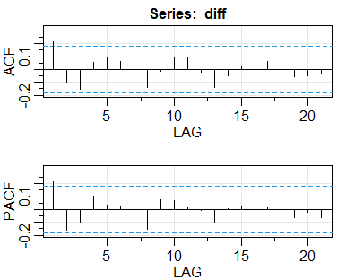
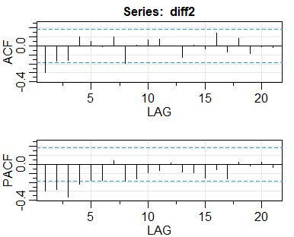
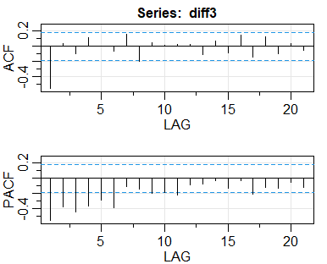
ACF and PACF

Slide 15
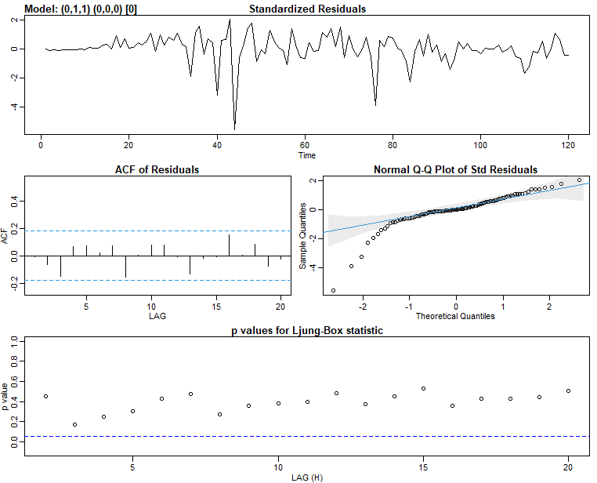
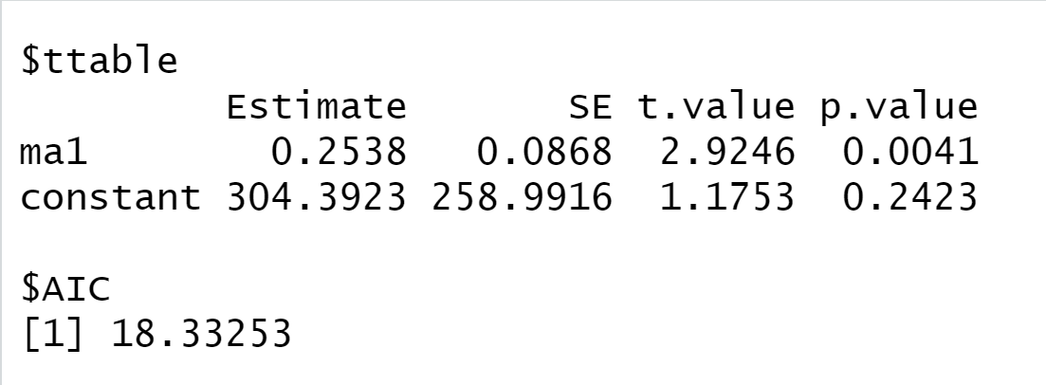
SARIMA(deaths,0,1,1,0,0,0,0)
Notes:
Used Matrix to find arma parts
AIC = 18.33253

Slide 16
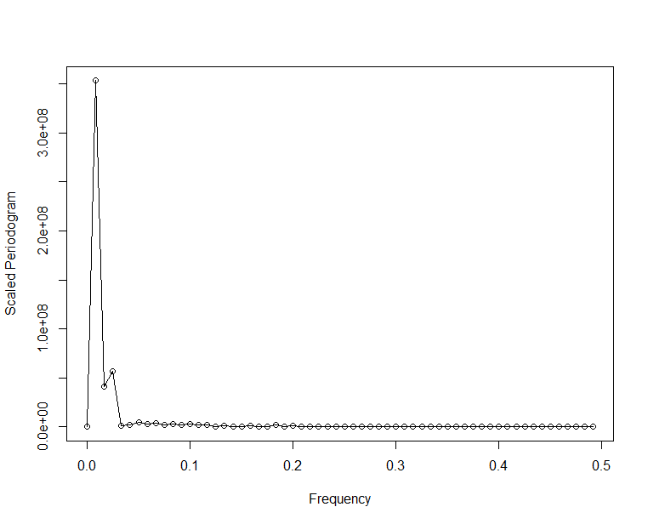
Exploring Periodic Patterns
Notes:
Period of 120 (ff = 1/120)

Slide 17
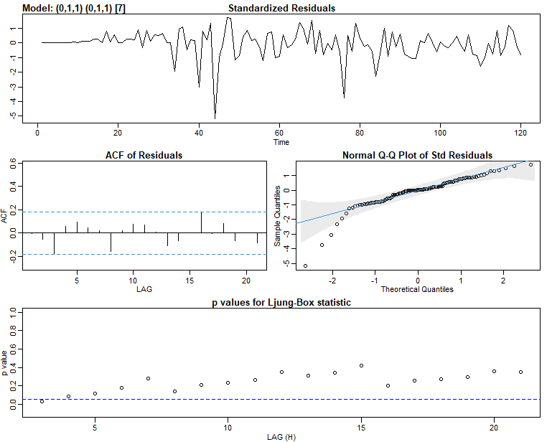
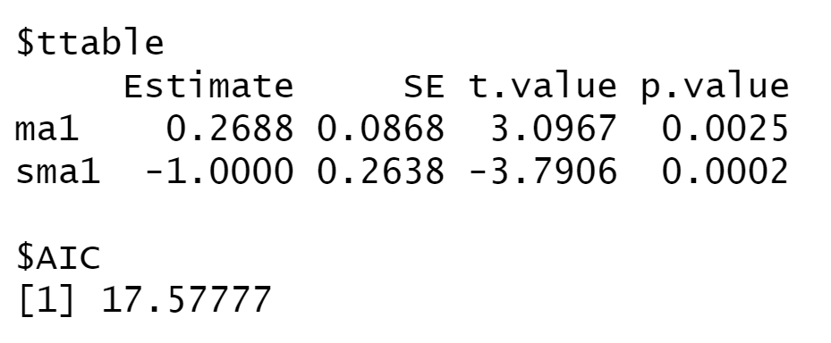
Seasonality: SARIMA(deaths,0,1,1,0,1,1,7)

Slide 18
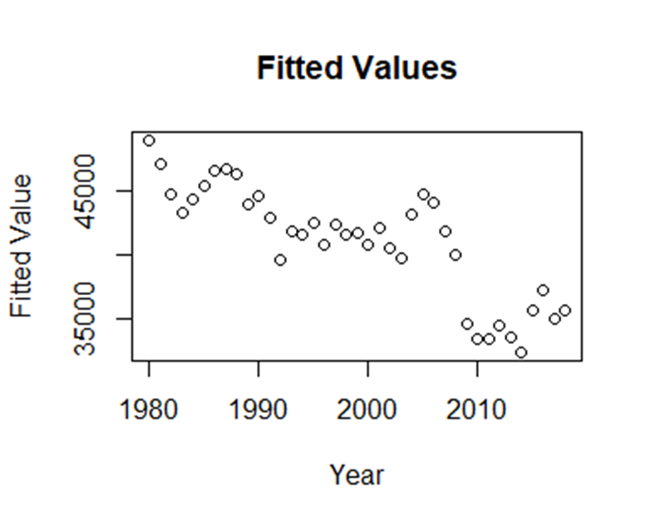
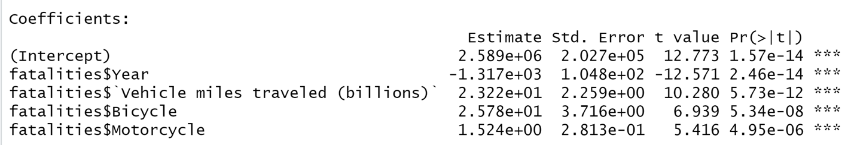
Linear Model
Year has the most effect
Year, VMT, Motorcycle Deaths, Bicycle Deaths
Starts in 1980
Bicycle is limiting factor
Residuals look like WN
Adjusted R-squared: 0.9153

Slide 19
Final Decision
No reasonable seasonality
SARIMA(deaths,0,1,1,0,0,0,0)
Linear model fit well
No lagged variables
No arma errors

Slide 20
since 1945

Slide 21
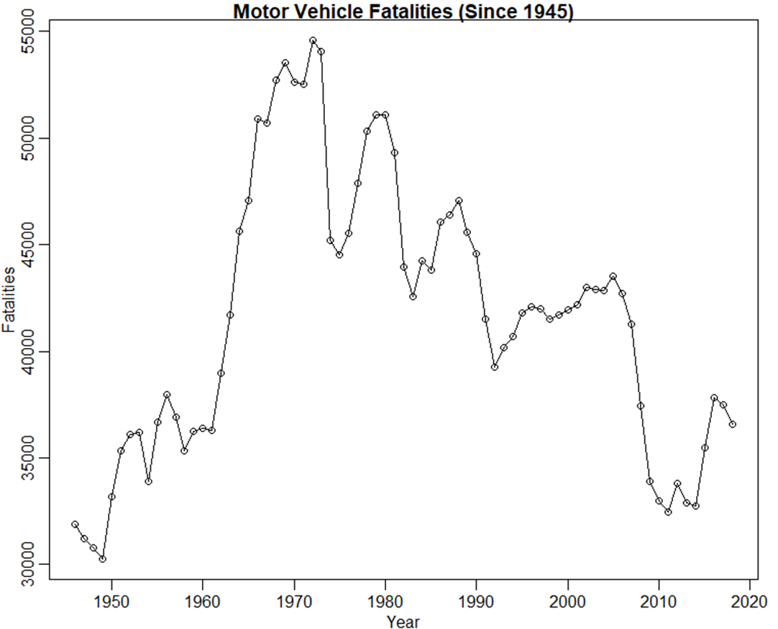

Slide 22
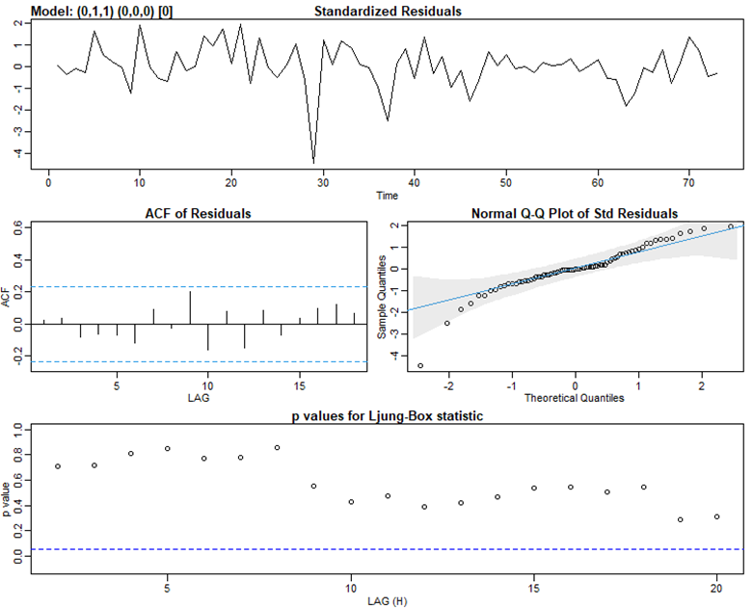
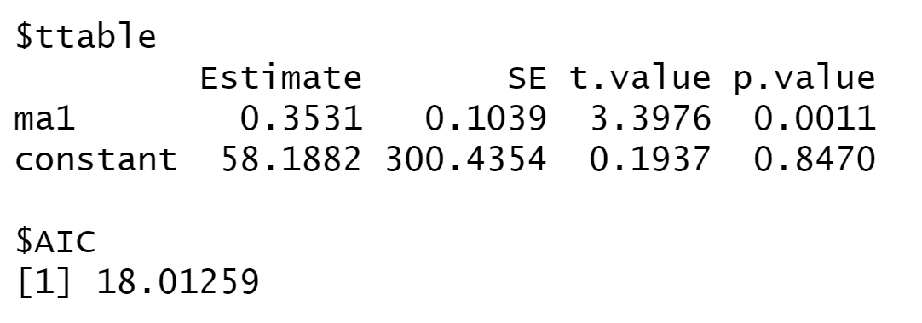
SARIMA(new_deaths,0,1,1,0,0,0,0)
Run with different cutoff years
All cutoffs are similar
All arima(0,1,1,0,0,0)

Slide 23
Forecasting

Slide 24
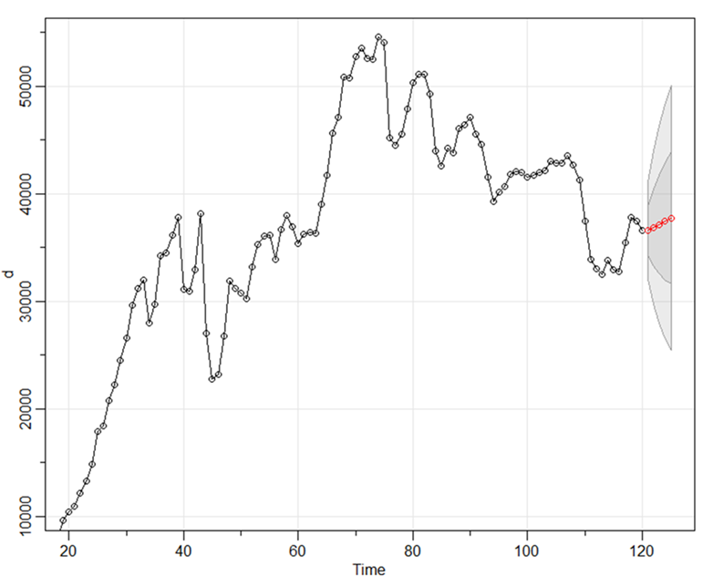
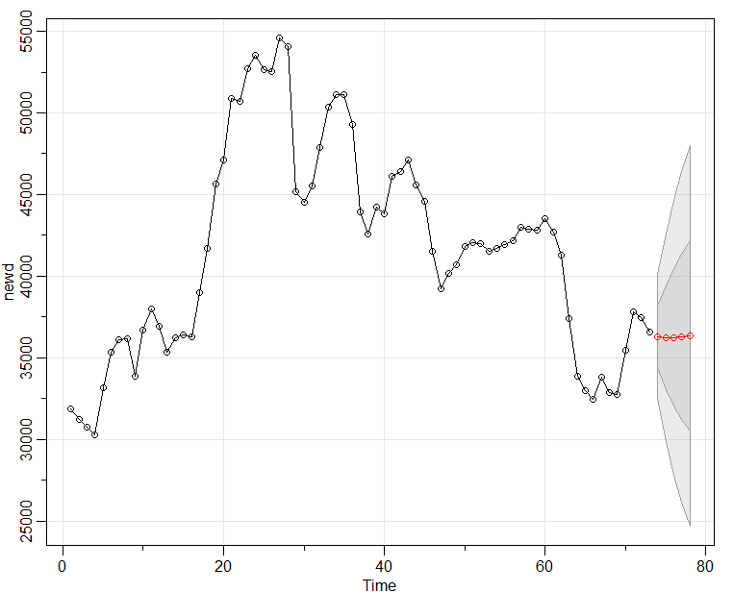
Forecasting Full vs Short Data

Slide 25
Forecasting Full vs Short Data

Slide 26
Forecasting Motor Vehicle Deaths
Year | Full Model | Shortened Model | Actual
2019 | 36,599.30 | 36,283.82 | 36,096
2020 | 36,845.39 | 36,224.60 | COVID
2021 | 37,136.39 | 36,239.28
2022 | 37,437.14 | 36,279.15
2023 | 37,740.00 | 36,327.59

Slide 27

Final thoughts
ARIMA model since 1945 (keep watch)
Breakdown by state
Indicator for seatbelt laws
Lagged variables for linear model
Models accounts for covid pretty well

Slide 28
Questions?

Slide 29
Images
https://www.peakefowler.com/how-often-do-seat-belts-fail/
https://64.media.tumblr.com/244d5e42334dbe0d8b43f0f16626c3db/tumblr_mvkcuc9aFA1shy8g6o1_500.gif
https://blog.nationwide.com/drivers-ed-requirements/
https://www.cnet.com/roadshow/news/coronavirus-covid-19-virus-car-tech-germs-hepa-ultraviolet-clean/

Slide 30
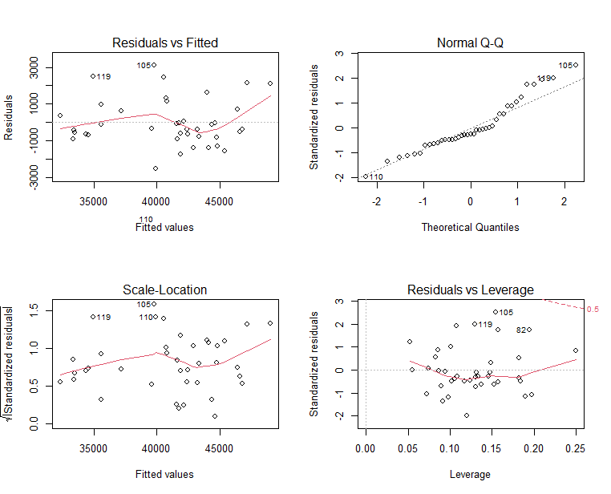
Notes:
ACF and PACF charts were good – no outliers, everything within what we’d expect

Slide 31
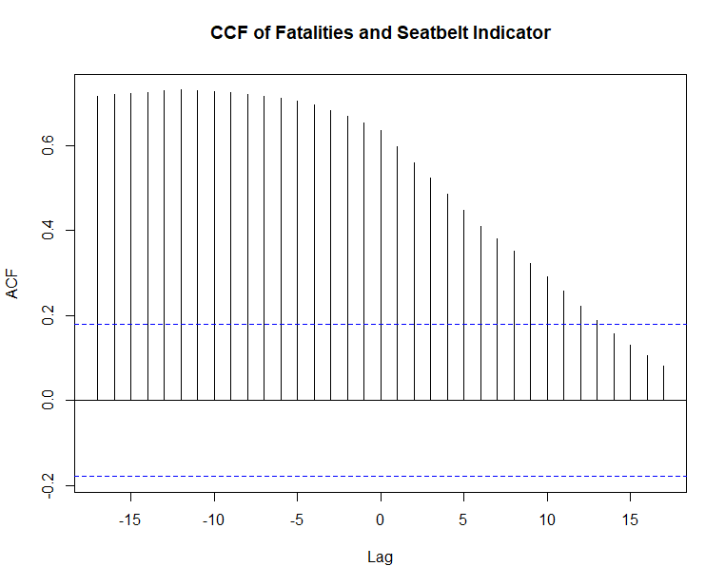
CCF(MV,Belt)
Fatalities predict seatbelt indicator

